Slide 1
A Tangle of Knots:
A Study Guide

Slide 2
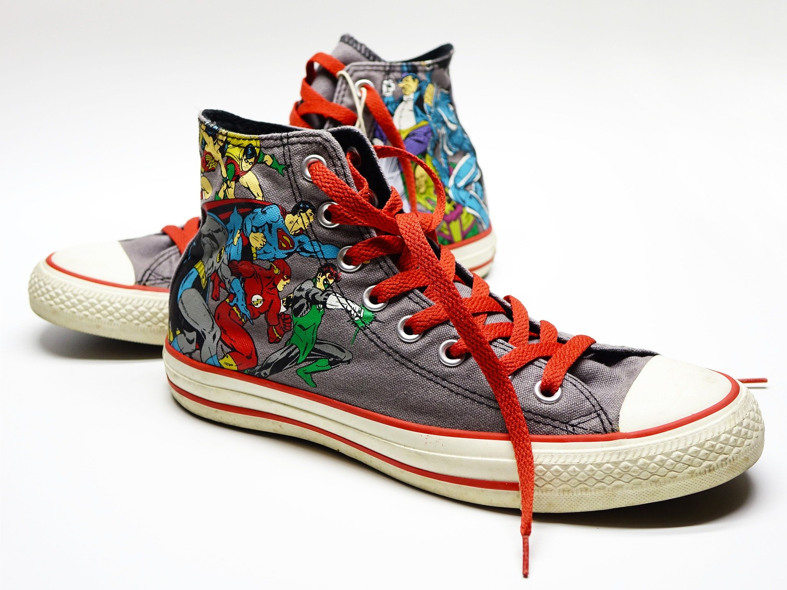
Do you like knots?
Do they cause problems?
Can they be useful?

Slide 3
Repeat Repeat Repeat
Repeating something is one way of emphasizing something important.
Author Lisa Graff uses repetition to help readers remember important ideas, things and people in her story.

Slide 4
What are some ways author Lisa Graff uses repetition in her book?
Look for repeated phrases.
Look for repeated sentences.
Look for particular items (or people) that keep popping up.

Slide 5
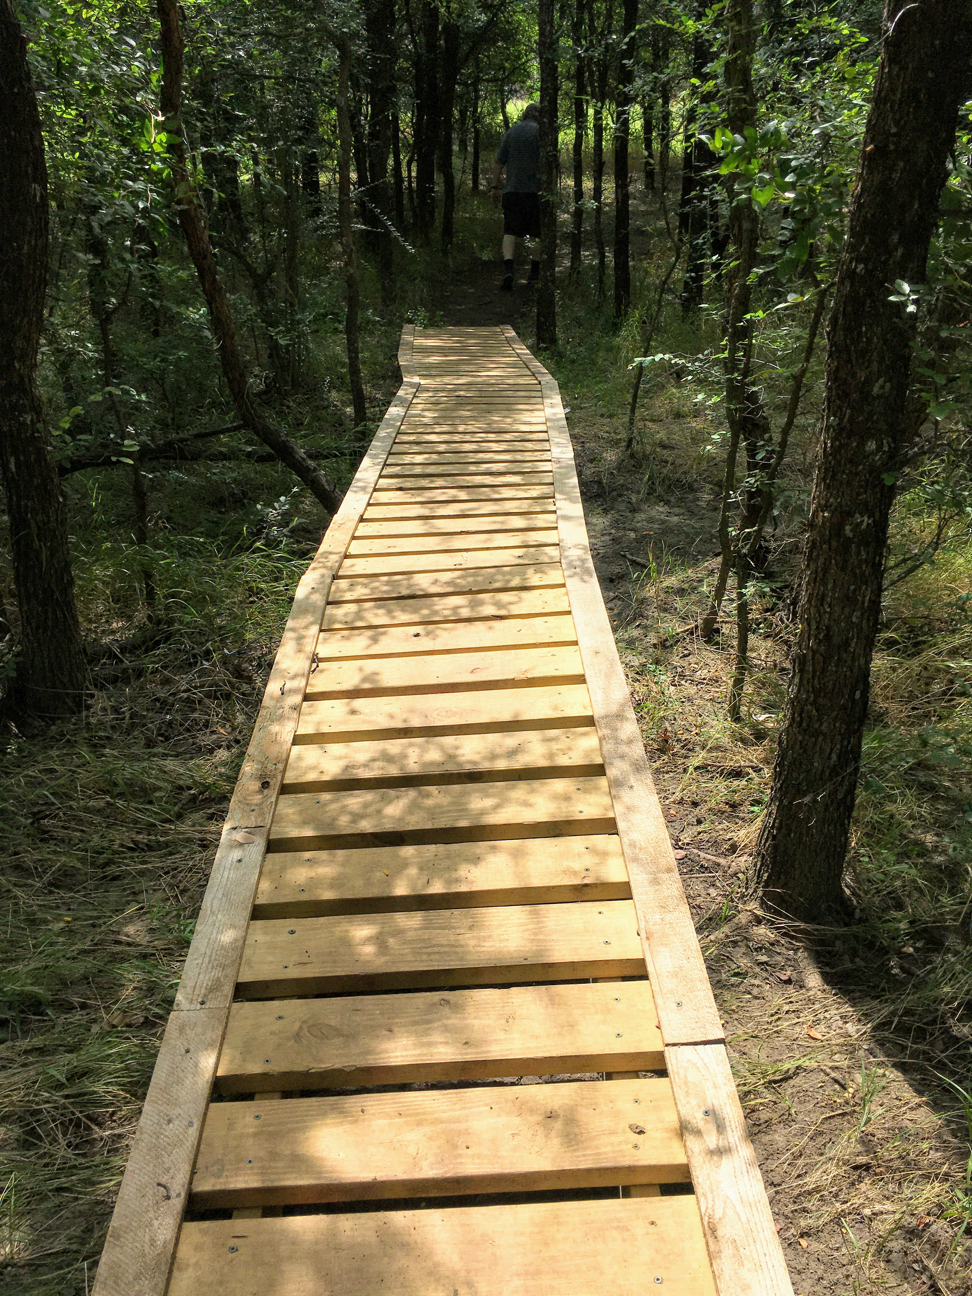
Follow your dreams!
Make a media presentation of your own about what you would like to do with your life.
What are your Talents? What are your interests? How can you get to where you want to go?

